Slide 1
IN VACUUM FLEXO TOP-COATING ON METALLIZED FILM:
AN UPDATE ON THE STATE OF THE ART
Dante Ferrari
Celplast Metallized Products Limited
Notes:
Celplast has given several presentations at past AIMCAL conferences discussing the film properties made available by its in-vacuum flexo top-coating process on metallized film. We have also explored, on a limited basis, how these films stand up to typical downstream converting processes. This presentation is designed to share the latest data that has been collected on these films, to give a fuller picture of how they perform in downstream processing.

Slide 2
Outline
Introduction
The in-line vacuum top-coating process
Flat sheet barrier performance
Market needs
Lamination & retort test data
Retort trials
Lamination trials
Scaling up
State of the Art
Conclusions
Notes:
We will start with a brief review of the process itself, as well as flat sheet barrier performance and why further data was needed in order to satisfy the interest of the flexible packaging converting market.
We will then examine the test results from two separate studies carried out over the past year: one on in-line top-coated metallized films in retort structures, the other in typical high barrier laminations.
Finally, we will look at the State of the Art in terms of scaling this process up to an economically viable commercial scale.

Slide 3
Introduction

Slide 4
The In-line Vacuum Coating Process
Won 2010 AIMCAL Technology of the Year Award
Notes:
This process was originally developed as a cost saving measure, to eliminate the need to metallize and then top-coat in two passes. Flexo printing was chosen as the top coating method, as it was the best way to apply a high viscosity liquid in a thin, even layer across the web. The top-coat is then E-beam cured in the same pass. A key feature of this technology is that all three processes occur one right after the other, with the metal surface never touching a roller until after the top-coat is cured. This technology was patented and commercialized under the trademark METACOAT, and won AIMCAL’s top Technology of the Year Award in 2010.
In 2011, we gave an AIMCAL paper looking at the energy reduction, material reduction and inventory reduction that would be possible by moving from a two-pass to a single-pass process. A carbon footprint calculation could be made based on these factors, which showed that this single-pass process could reduce the carbon footprint of this film by ~ 25% over a two-pass process.

Slide 5
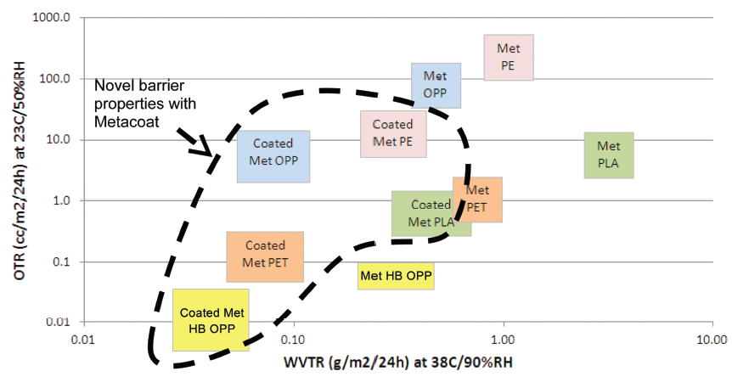
Flat Sheet Barrier Properties
By applying the top-coating immediately after metallizing, before the metal surface touched another roll, barrier properties are significantly improved
Notes:
One of our early findings was that since the top-coat is applied immediately after metallizing, the inherent barrier of the aluminum layer is retained and protected. Therefore, the barrier properties achieved with this process are significantly improved over standard high barrier metallizing.
This slide shows a barrier map with OTR and WVTR in metric units on a log-log scale. The same-coloured boxes represent the same substrate run on the same metallizer under the same vacuum conditions, with the coating being applied or not. As you can see, a barrier improvement of 6 – 8x on average is achievable with this technology over high barrier metallizing on its own. This means that metallized films such as LDPE and PLA, which were formerly considered not very good barrier materials, can now achieve barrier properties in the same range as metallized BOPP and PET, respectively. Metallized films such as PET and high barrier BOPP’s are now able to achieve barrier properties in the same range as foil.

Slide 6
Market Needs
Several potential markets for these high barrier films were identified, including flexible packaging
Starting in 2011, Celplast began to partner with converters and brand owners to develop new packaging structures & applications
One question kept coming up: how does this top-coated metallized film perform in downstream converting equipment and finished package applications?
Notes:
Celplast began partnering with converters and brand owners to develop new structures, and this began the journey to compile a database of films, adhesives and inks that could be applied to this coated film.

Slide 7
Market Needs
In 2013, Celplast partnered with Dow to study barrier in different adhesive laminations, both before & after Gelbo flexing
In 3-ply PET/met PET/LDPE with solvent-based laminations, lamination with top-coated metallized film had much better OTR in flat sheet and after Gelbo-flexing, no change in WVTR
In 3-ply PET/met PET/LDPE with solventless & water-based laminations, found that both OTR & WVTR were greatly improved over HB met PET, both in flat sheet and after Gelbo flexing
Notes:
In order to generate data that could be published, in 2013 Celplast partnered with Dow to look at a variety of 3-ply adhesive laminations using top-coated metallized PET films, and comparing them directly to our highest barrier metallized PET.
We found that for solvent-based laminations, the OTR was significantly improved, both before & after Gelbo flexing. WVTR was excellent in both the coated & uncoated structures.
For SL & WB laminations, both OTR & WVTR were significantly improved in the top-coated metallized film structures, both before & after Gelbo flexing. This suggested that the top-coating not only assisted in protecting the aluminum layer to give improved barrier immediately after metallizing, but it kept protecting it in downstream laminating & Gelbo flexing processes.

Slide 8
Market Needs
There were still unanswered questions:
How do these coated films perform in the most demanding packaging applications, such as retort?
How can these films be made on large scale production equipment, so they are commercially viable?
Recently, we have been working to build our knowledge base with new adhesive lamination & retort studies
To make this commercially viable, we also needed to scale up the process
Notes:
There were still gaps in the knowledge base. <Read slide>
In particular, there were commercial adhesive systems that had not yet been explored with the top-coated metallized films. Also, there were new structures in the areas of foil replacement and layer elimination that had not yet been examined. The studies we and our partners undertook over the past year were designed to fill in some of these gaps, and will be presented today.

Slide 9
Retort Trials
Notes:
First we will look at the top-coated metallized film performance in what is generally recognized as the most demanding flexible packaging application today, retort pouches.

Slide 10
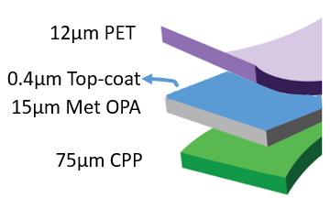
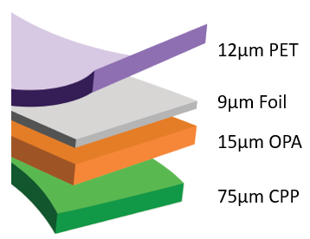
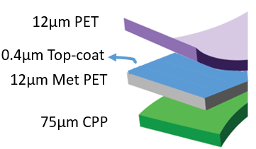
Retort Structures
New structure #1:
Standard structure:
New structure #2:
Notes:
On the left is a typical retort pouch structure. You can see it consists of 4 plies, with the 9 micron foil acting as the primary barrier layer. The OPA layer is there to assist the pouch, particularly the stiff foil layer, in absorbing the stresses imparted in the pouch during the retort process.
On the right are two potential 3-ply alternatives to the 4-ply structure. In each case, a top-coated metallized film is being used to replace both the foil and OPA layers. In Structure #1, this was done with a top-coated metallized retort grade OPA. In Structure #2, this was done with a top-coated metallized chemically treated PET.

Slide 11
Retort Study – Sample Preparation
Structures tested with sheet samples
Hand drawdowns made with a Henkel solvent-based Loctite Liofol LA3649:LA6055 @ 3.4 g/m² dry coat weight
Adhesive applied to clear PET, then nipped to top-coated side of metallized film, then applied to CPP, and nipped to non-coated side of metallized film
Entire structure was cured at 50°C for 4 days prior to bond testing & retorting
Notes:
Laminations were prepared at Henkel’s R&D facility in Cary, NC. The adhesive system was <describe application>.

Slide 12
Retort Study – Bond Strength Tests
Bond tests carried out at 90° angle to direction of separation, using 25 mm strips at 30 cm/min peel speed
Notes:
In bond testing, the CPP film bonded well to the non-coated side of each barrier test film.
The weak layer in the top-coated metallized OPA structure was the metal-to-OPA. This could potentially be improved with further optimization work.
The top-coated metallized PET structure showed excellent bond throughout, with the failure mode being stock split of the clear PET film. This suggests that the adhesive-to-top-coating bond, the top-coat-to-metal bond, and the metal-to-PET bond were all superior to this.

Slide 13
Retort Study – Pouch Study
4-side seal pouches were prepared, and filled with DI water
Pouches were put into a retort chamber and processed at 121°C for 60 minutes in water spray mode
There was noticeable delamination in the first structure during retort, between the clear PET / top-coated OPA film layers; also the OPA/CPP portion of the structure shrank somewhat relative to the clear PET
There was no noticeable delamination or shrinkage in the second structure, containing top-coated PET
Notes:
Then 4-side seal pouches were prepared and filled with DI water. This was put through a standard retort condition of 121 C, 60 minutes with water spray cooling.
<Describe pouch delamination>

Slide 14
Retort Study
121°C, 60 minutes, water spray cooling
OPA
PET
Notes:
As is clearly shown in this photo, the metallized layer in the pouch on the left has gone completely clear. This is likely due to the delamination of the OPA exposing the metal layer to the retort process, or moisture wicking in from the edges of the OPA film itself attacking the metal.
The metallized layer in the pouch on the right remained completely intact. This is the first example we have ever seen where a metallized structure has withstood a retort test without any noticeable delamination or clearing of the metal layer.
Unfortunately, these pouches were too small to be able to carry out post-retort barrier testing. A subsequent study will be carried out with Henkel to verify these results and test post-retort barrier properties on the top-coated metallized PET film 3-ply structure.

Slide 15
Lamination Trials
Notes:
Concurrently with the retort study, we decided to carry out further lamination trials with different high barrier structures containing the top-coated metallized PET film.

Slide 16
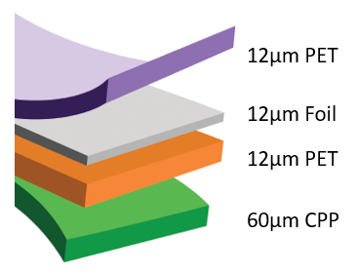
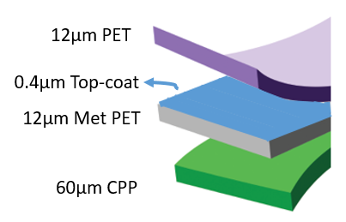
Lamination Structures: High Barrier with CPP Sealant
Standard structure:
New HB structure:
Notes:
As with the previous study, we compared a high barrier 4-ply retort-type pouch structure containing a very thick 12 micron foil layer as the barrier layer vs. a 3-ply retort pouch structure containing the top-coated metallized PET film.

Slide 17
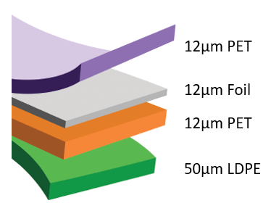
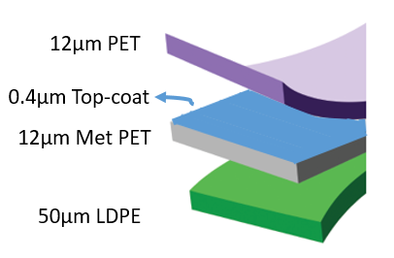
Lamination Structures: High Barrier with LDPE Sealant
Standard structure:
New HB structure:
Notes:
In addition, we compared a 4-ply foil-based structure that could be used for non-retort high barrier packaging with an analogous 3-ply structure containing the top-coated metallized PET film.

Slide 18
Lamination Study – Preparation
Structures screened with sheet samples first, then roll-to-roll lamination
Laminations made with COIM Novacote NC 825A:CA 26 @ ~ 3 g/m² dry coat weight
Adhesive applied to clear PET, then nipped to top-coated side of metallized film, then applied to CPP, and nipped to non-coated side of metallized film
Entire structure was cured at 50°C for 5 days prior to bond & barrier testing
OTR measured at 23°C, 50%RH
WVTR measured at 37.8°C, 90%RH
Notes:
Laminations were prepared on a pilot line by the Fraunhofer IVV institute in Freising, Germany. As in the Henkel study, adhesive was applied to <Describe process>
The difference in this study was that a COIM SB adhesive system was used for each lamination pass. In addition to bond testing, we also carried out barrier testing on all samples after lamination.

Slide 19
Bond & Barrier Data: High Barrier with CPP Sealant
Standard structure:
New HB structure:
Barrier levels are suitable for retort & hot fill packaging applications
Notes:
The bond strengths at each interface of the lamination as well as the barrier properties of each structure are shown here. This slide shows the performance of the foil-based vs. top-coated metallized PET-based retort pouch structures.
As expected, the 12 micron foil structure gave good bonds and barrier levels below the detection limit of the MOCON measuring systems in flat sheet form.
The top-coated metallized PET structure gave a lower bond on one side than the foil based structure, but still a suitable number for typical pouch applications. Furthermore, the barrier numbers after lamination remained as good as or slightly better than what we saw in the top-coated metallized PET sheet before lamination. These values would meet the barrier requirements of typical retort or hot fill pouch applications.

Slide 20
Bond & Barrier Data: High Barrier with LDPE Sealant
Standard structure:
New HB structure:
Barrier levels are suitable for most non-retort packaging applications
Notes:
Similarly, this slide shows the performance of the foil-based vs. top-coated metallized PET-based non-retort high barrier pouch structures.
Once again, the 12 micron foil structure gave good bonds and barrier levels below the detection limit of the MOCON measuring systems in flat sheet form.
The top-coated metallized PET structure gave slightly lower bonds than the previous structure, particularly on the sealant-to-PET side. However, these are still suitable values for typical pouch applications. The oxygen barrier number after lamination remained as good as the pre-laminated flat sheet, but the moisture barrier in this case did degrade slightly. This warrants further study. Regardless, these values are still suitable for the majority of non-retort high barrier pouch applications.

Slide 21
Scaling Up
Notes:
The final piece of the puzzle is: does this process scale so the economics make sense for this process to be used in large scale commercial food packaging applications?
The top-coated metallized film used in all the previous studies was produced on a 1.5 m wide pilot line in Toronto. The question now is: are we able to generate similar film performance in a commercial, high speed production machine?

Slide 22
The State of the Art
Scaling process up from 2 m/s to 6 m/s
Also going from 1320 mm wide coating on pilot line to 2450 mm wide coating
Requires outside-the-box thinking: a dedicated team that has overcome many obstacles, and is continuing to overcome challenges on the road to commercialization
Notes:
While the 1.5 m wide pilot line has been useful to develop the technology and generate sales in the market, it was not sufficient to generate top-coated metallized films on a commercial scale. Therefore, in spite of this being a relatively new technology, we have been ambitious in our scale-up. Not only is, but we were looking to go much faster, wider, and with quicker roll changeovers as well.
We have had success over several rolls run on the production tool, but final modifications are still underway to ensure these results are reproducible on a long term basis. We anticipate the tool to be installed and up and running, fully functional, in Toronto in Q1 2017.

Slide 23
Conclusions
By applying an in-line top-coating to metallized PET, we have been able to produce a metallized film that passes the retort process
This is an economically feasible alternative to foil, with potential for layer elimination as well
Top-coated metallized OPA did not work well in bond strength and retort testing; further work is being carried out to develop a solution
Notes:
In the retort study, we have proven that a top-coated metallized PET film could be a viable alternative barrier layer to foil. The top-coated metallized OPA film was not successful, possibly due to the poor metal-to-OPA bonds.

Slide 24
Conclusions
Top-coated metallized PET also shows promise in applications for foil replacement and layer elimination in other high barrier structures, which use either a CPP or LDPE sealant
Celplast is moving forward with the first commercial production line with this capability
Notes:
In the pilot line lamination study, with both retort and non-retort pouch structures, we have seen that going from a 4-ply foil-based structures to 3-ply top-coated metallized film structures is a distinct possibility. The latter offers sufficient bond strengths, both with the Henkel adhesive system looked at in the first study and with the COIM adhesive from the second study.

Slide 25
Special Thanks
To Nicholas Enders and the team at Henkel in Cary, NC for collecting much of the data for the retort section of this presentation
To Dr. Klaus Noller and Norbert Rodler and the team at Fraunhofer IVV for collecting much of the data for the lamination section of this presentation
Notes:
Many thanks to the team at Henkel…
Also to the team at Fraunhofer IVV…

Slide 26
Further Information
Celplast is the first licensee of the Metacoat® inline top-coating process in the industry
For more information on the Metacoat® process, please visit Metallized Surface Technologies (MST) at Booth #23 at the table top reception
Contact information:
Office – 416-644-3507
Cell – 416-918-8790
E-mail - dante@celplast.com
Website – www.celplast.com

